Slide 1
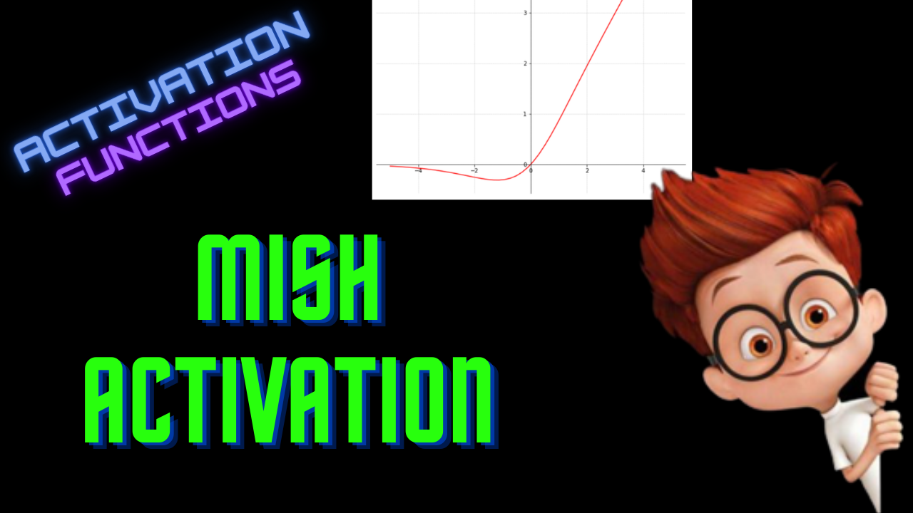

Slide 2
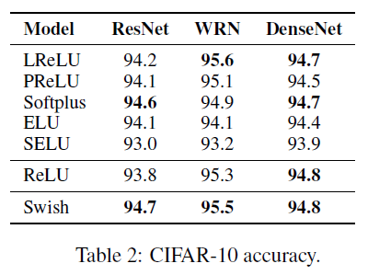
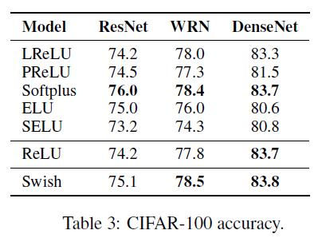
Swish Activation

Slide 3
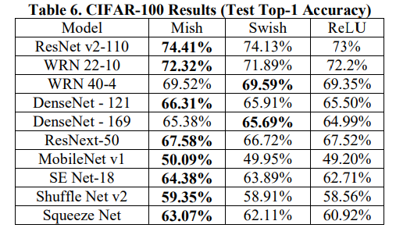
Mish Activation

Slide 4
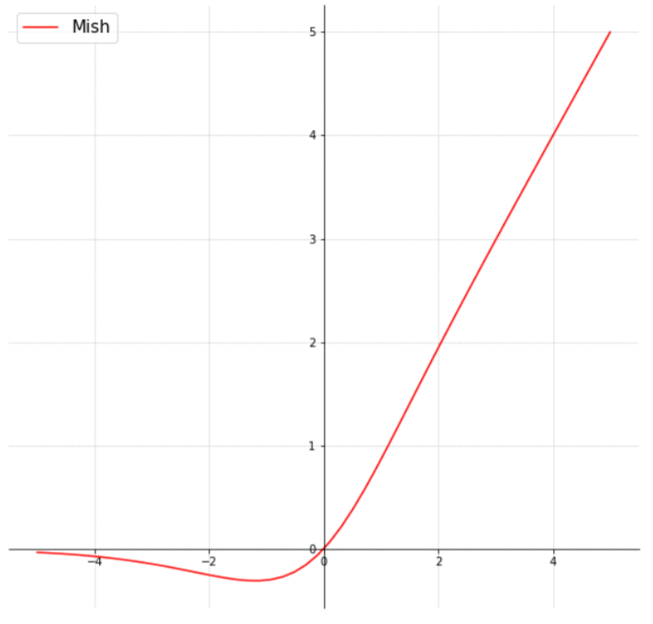
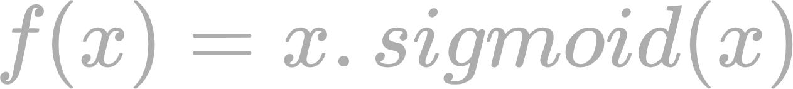
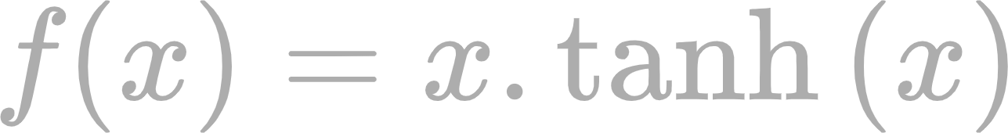
Mish Activation

Slide 5
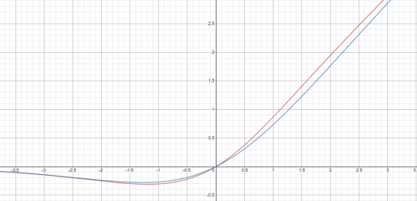
Mish Vs Swish
Mish
Swish

Slide 6
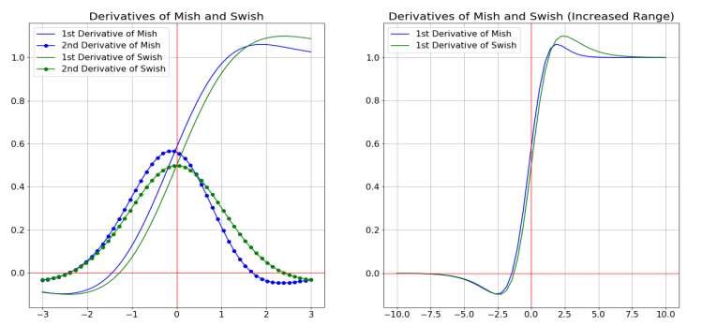
Derivative of Mish

Slide 7
Properties
Continuous
Non-monotonicity
Zero-centered
Unbounded

Slide 8
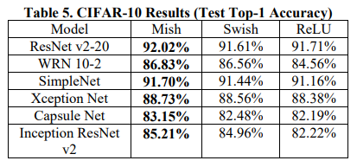
Performance

Slide 9
Performance

Slide 10
Ablation Studies

Slide 11
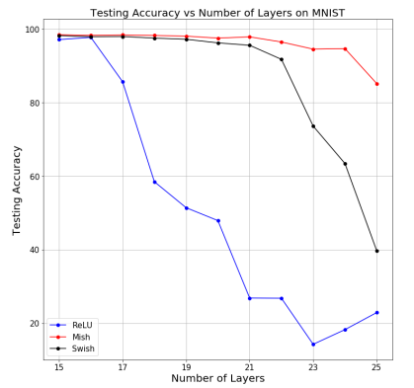
Ablations - Number of Layers

Slide 12
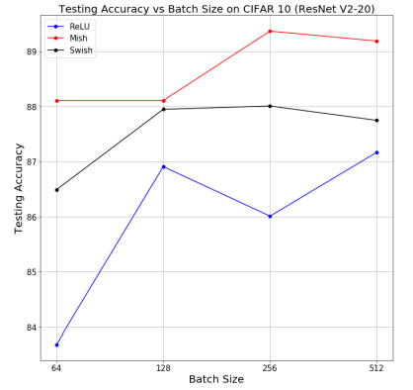
Ablations - Batch Size

Slide 13
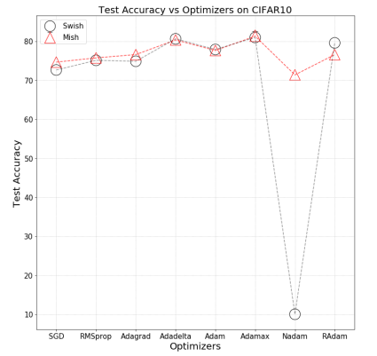
Ablations - Optimizers

Slide 14
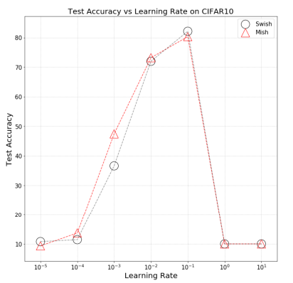
Ablations - Learning rates

Slide 15
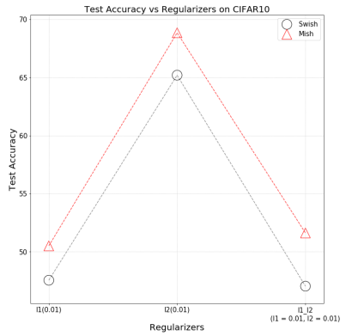
Ablations - Regularizers

Slide 16
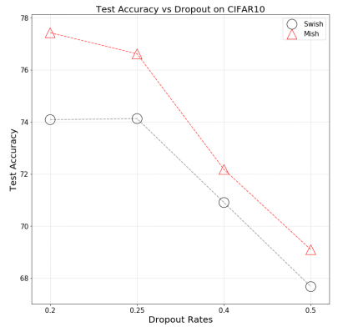
Ablations - Dropout

Slide 17
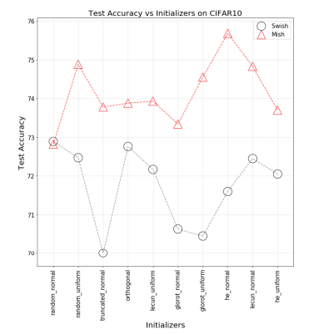
Ablations - Weight Initialization

Slide 18
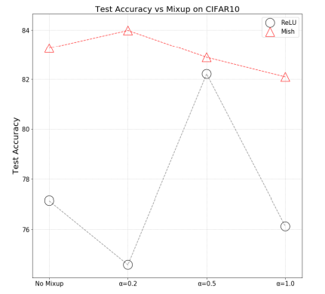
Ablations - Data Augmentation

Slide 19
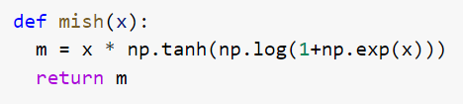
Python Implementation

